Slide 1
Imbalanced Data
Dr. Harpreet Singh

Slide 2
Evaluation Metrics

Slide 3
Goal
Before picking a machine learning metric, you should think about the high-level goal of the application, often called the business metric.
The consequences of choosing a particular algorithm for a machine learning application are called the business impact.

Slide 4
Imbalanced Dataset
Fraud Detection
Claim Prediction
Default Prediction
Churn Prediction
Spam Detection
Anomaly Detection
Outlier Detection
Intrusion Detection
Conversion Prediction

Slide 5
Dummy classifiers completely ignore the input data!
Dummy classifiers serve as a sanity check on your classifier's performance.
They provide a null metric(e.g. null accuracy) baseline.
Dummy classifiers should not be used for real problems.

Slide 6
Dummy classifiers completely ignore the input data!
Some commonly-used settings for the strategy parameter for DummyClassifierin scikit-learn:
most_frequent: predicts the most frequent label in the training set.
stratified: random predictions based on training set class distribution.
uniform: generates predictions uniformly at random.
constant: always predicts a constant label provided by the user.
A major motivation of this method is F1-scoring, when the positive class is in the minority.

Slide 7
Binary Classification

Slide 8
Errors
False Positive
Type I error
False Negative
Type II error

Slide 9
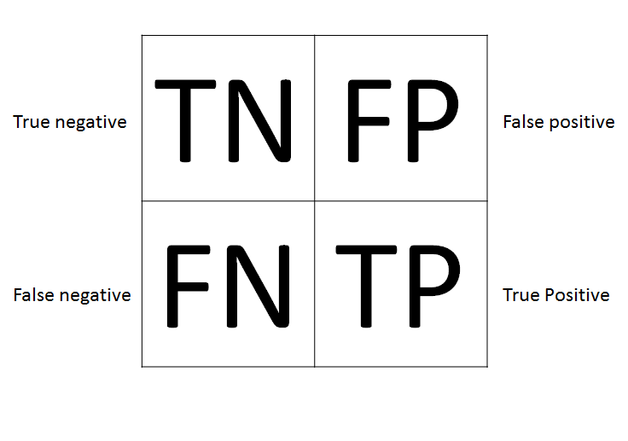
Confusion Matrix - A Two-class Problem
Predicted class
Negative
Positive
Negative
True Negatives (TN) | False Positives (FP)
False Negatives (FN) | True Positives (TP)
Actual class
Positive
We will use the following notation in all slides

Slide 10
Confusion Matrix
Negative
Positive

Slide 11
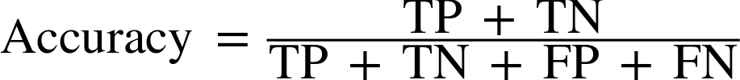
Acccuracy
5 | 1
2 | 6
Accuracy = (5 + 6) / (5 + 1 + 2 + 6) = 0.7857

Slide 12
Accuracy
5 | 1
2 | 6
Accuracy = (5 + 6) / (5 + 1 + 2 + 6) = 0.7857

Slide 13
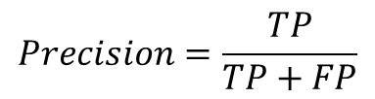
Precision
$$Precision=\frac{TP}{TP+FP}$$
5 | 1
2 | 6
It is calculated as the ratio of correctly predicted positive examples divided by the total number of examples that were predicted positive
Denominator is total number of predicted positive examples
It ignores False Negatives (One classified as zero )
It minimizes False Positives
Will you use it for predicting Spam detection or Cancer detection?
Spam or 1 or positive class or minority class,
Not spam, 0 or majority class
Precision= 6 / (6+1) = 0.8571
250 | 1
20 | 6
Precision= 6 / 7 = 0.8571
Consider a dataset with a 1:100 minority to majority ratio, with 100 minority examples and 10,000 majority class examples. A model makes predictions and predicts 120 examples as belonging to the minority class, 90 of which are correct, and 30 of which are incorrect.
Precision = 90/120=0.75
251 | 0
25 | 1
Consider the same dataset, where a model predicts 50 examples belonging to the minority class, 45 of which are true positives and ﬁve of which are false positives.
Precision = 45/50=0.90
Precision= 1 / 1 = 1

Slide 14
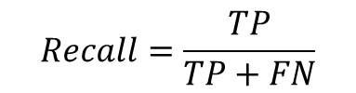
Recall
$$Recall=\frac{TP}{TP+FN}$$
5 | 1
2 | 6
Recall= 6 / (6+2) = 0.75
It is calculated as the ratio of correctly predicted positive examples divided by the total number of positive examples in the data
Denominator is total number of positive examples in the data.
It ignores False Positives (Zero classified as One )
It minimizes False Negatives
Will you use it for predicting Spam detection or Cancer detection?
Spam or 1 or positive class or minority class,
Not spam, 0 or majority class
250 | 10
2 | 6
Recall= 6 / 8 = 0.8571
Naïve classifier : Predict everything as 1
0 | 260
0 | 8
Consider a dataset with a 1:100 minority to majority ratio, with 100 minority examples and 10,000 majority class examples. A model makes predictions and predicts 120 examples as belonging to the minority class, 90 of which are correct, and 30 of which are incorrect.
Precision = 90/100=0.90
Recall= 8 / 8 = 1
Naïve classifier : Predict everything as 0
Consider the same dataset, where a model predicts 50 examples belonging to the minority class, 45 of which are true positives and ﬁve of which are false positives.
Precision = 45/100=0.45
260 | 0
8 | 0
Recall= 0 / 8 = 0
Recall =True Positive Rate = Sensitivity

Slide 15
Accuracy | 0.8571
Precision | 1
Recall | 0.75
Accuracy | 0.9286
Precision | 0.8889
Recall | 1
Negative
Positive

Slide 16
Precision-Recall trade off
Recall-oriented machine learning tasks:
Search and information extraction in legal discovery
Tumor detection
Often paired with a human expert to filter out false positives
Precision-oriented machine learning tasks:
Search engine ranking, query suggestion
Spam email detection
Document classification
Many customer-facing tasks (users remember failures!)

Slide 17
Precision/Recall for Multiclass Classification
Macro-Average
Micro-Average

Slide 18
Micro Average
Each instance has equal weight.
Largest classes have most influence
Aggregate outcomes across all classes
Compute metric with aggregate outcomes

Slide 19
Micro Avearge Precision and Recall
There are three classes. We have 100 examples in each minority class, and 10,000 examples in the majority class. A model makes predictions and predicts 70 examples for the ﬁrst minority class, where 50 are correct and 20 are incorrect. It predicts 150 for the second class with 99 correct and 51 incorrect.
$$Precision=\frac{TP_{1}+TP_{2} }{TP_{1}+TP_{2}\text{+ }FP_{1}+FP_{2} }=\frac{50+99}{70+150}=0.677$$
$$Recall=\frac{TP_{1}+TP_{2} }{(TP_{1}+FN_{1})+(TP_{2}\text{+ }+FN_{2}\text{)} }=\frac{50+99}{100+100}=0.745$$
Scikit Learn Tip : When using the precision score() or recall score() function for multiclass classiﬁcation, it is important to specify the minority classes via the labels argument and to set the average argument to ‘micro’.

Slide 20
Macro Average
Each class has equal weight.
Compute metric within each class
Average resulting metrics across classes

Slide 21
Example
Class | Predicted Class | Correct
Orange | Lemon | 0
Orange | Lemon | 0
Orange | Apple | 0
Orange | Orange | 1
Orange | Apple | 0
Lemon | Lemon | 1
Lemon | Apple | 0
Apple | Apple | 1
Apple | Apple | 1
Class​ | Predicted Class​ | Correct​
Orange​ | Not Orange | 0​
Orange​ | Not Orange | 0​
Orange​ | Not Orange | 0​
Orange​ | Orange​ | 1​
Orange​ | Not Orange | 0​
Not Orange | Not Orange | 1​
Not Orange | Not Orange | 0​
Not Orange | Not Orange | 1​
Not Orange | Not Orange | 1​
Class​ | Predicted Class​ | Correct​
1 | 0 | 0​
1​ | 0 | 0​
1 | 0 | 0​
1​ | 1 | 1​
1​ | 0 | 0​
0 | 0 | 1​
0 | 0 | 0​
0 | 0 | 1​
0 | 0 | 1​
TP: 1
FP: 0
Precision = 1

Slide 22

Example
Class | Precision
Orange | 1
Lemon | 0.33
Apple | 0.4
Macro Average Precision =

Slide 23
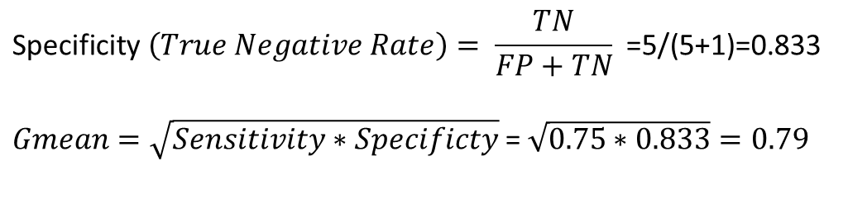
Other Measures
5 | 1
2 | 6
Recall (Sensitivity or True Positive Rate ) = 6 / (6+2) = 0.75
$$\text{Specificity} \left(True Negative Rate\right)= \frac{TN}{FP+TN} \text{=5/(5+1)=0.833}$$
$Gmean=\sqrt{Sensitivity∗Specificty}$= $\sqrt{0.75∗0.833}=0.79$

Slide 24
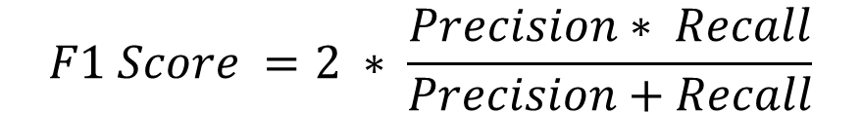
F1-Score
Precision: Appropriate when minimizing false positives is the focus.
Recall: Appropriate when minimizing false negatives is the focus.
Sometimes, we want excellent predictions of the positive class. We want high precision and high recall. This can be challenging, as often increases in recall often come at the expense of decreases in precision.
$$F1 Score =2 ∗ \frac{Precision∗ Recall}{Precision+Recall}$$

Slide 25
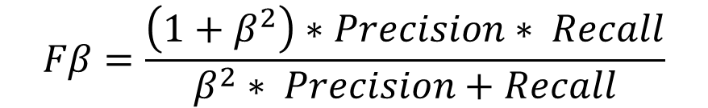
Fbeta- Measure
$$Fβ=\frac{\left(1+β^{2}\right)∗Precision∗ Recall}{β^{2}∗ Precision+Recall}$$
F0.5-measure (β = 0.5): More weight on precision, less weight on recall.
F1-measure (β = 1): Balance the weight on precision and recall.
F2-measure (β = 2): Less weight on precision, more weight on recall.

Slide 26
Taking Uncertainty into Account
decision_function
predict_proba

Slide 27
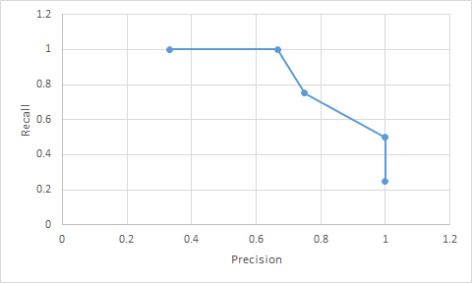
Precision-Recall Curves
Plot of Recall (x-axis) vs Precision (y-axis
classifier score threshold | Precision | Recall
-20 | 0.33333333 | 1
-10 | 0.66666667 | 1
0 | 0.75 | 0.75
10 | 1 | 0.5
20 | 1 | 0.25
True Label | Classifier score
0 | -27.6457
0 | -25.8386
0 | -25.1011
0 | -24.1511
0 | -23.1765
0 | -22.575
0 | -21.8271
0 | -21.7226
0 | -19.7361
0 | -19.5768
0 | -19.3071
0 | -18.9077
0 | -13.5411
0 | -12.8594
1 | -3.9198
0 | -1.9798
1 | 1.824
0 | 4.74931
1 | 15.234624
1 | 21.20597
The precision_recall_curve function returns a list of precision and recall values for all possible thresholds

Slide 28
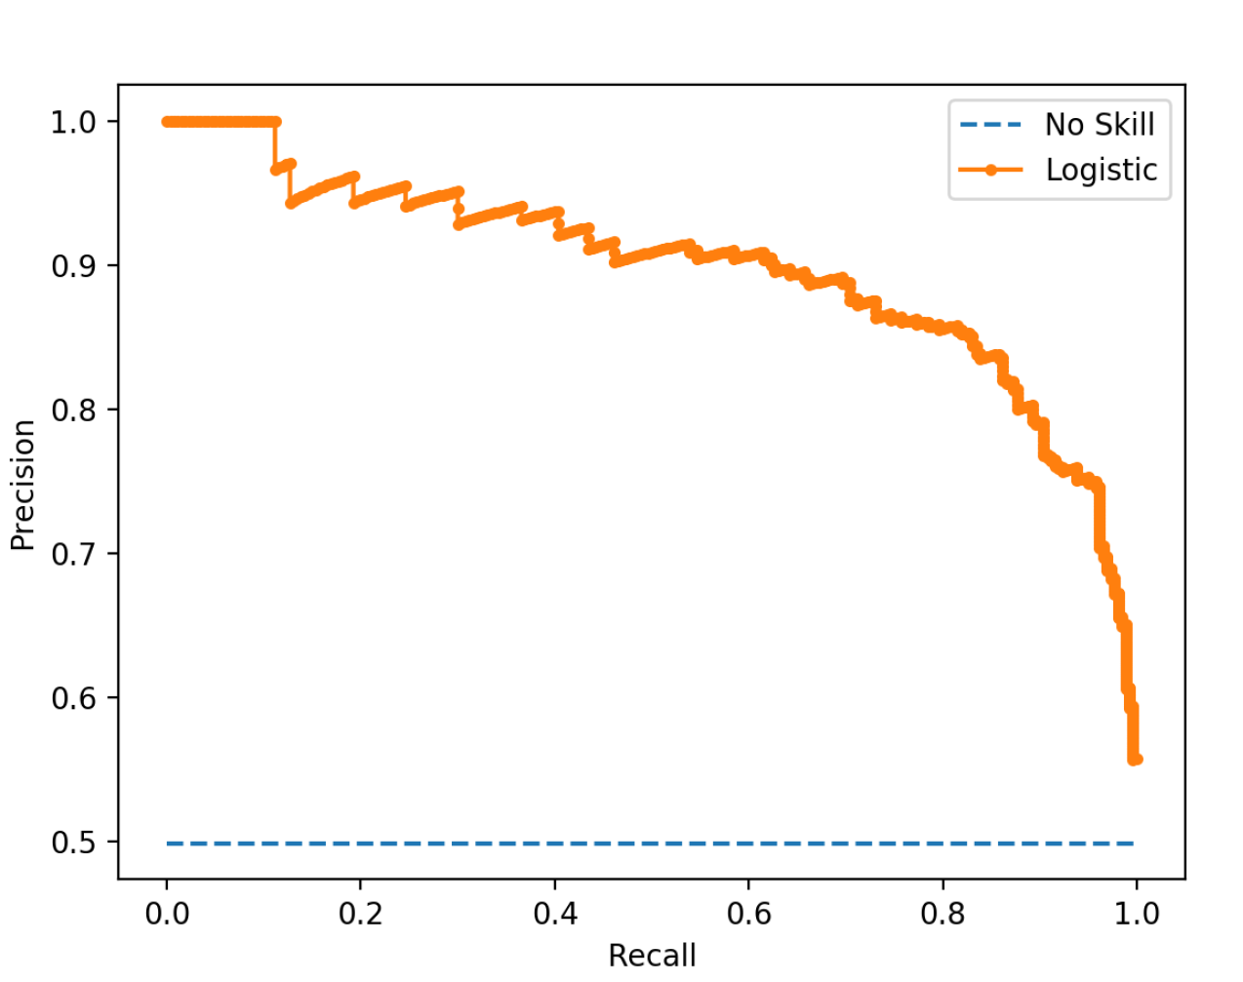
Precision-Recall Curve
Both the precision and the recall are focused on the positive class (the minority class) and are unconcerned with the true negatives (majority class).
The focus of the PR curve on the minority class makes it an eﬀective diagnostic for imbalanced binary classiﬁcation models.

Slide 29


Receiver Operating Characteristics (ROC)
ROC is a tool that is commonly used to analyze the behavior of the classifier at different threshold.
Plot of False Positive Rate (x-axis) vs. True Positive Rate (Recall) (y-axis)
$$False Positive Rate(FPR)=\frac{FP}{FP+TN}$$
% of zeros classified as 1
$$True Positive Rate\left(TPR\right)=Recall=\frac{TP}{FN+TP}$$
% of ones classified as 1

Slide 30
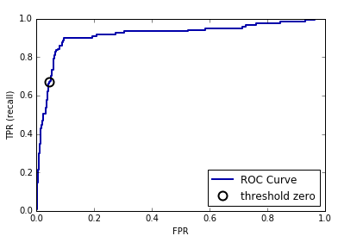
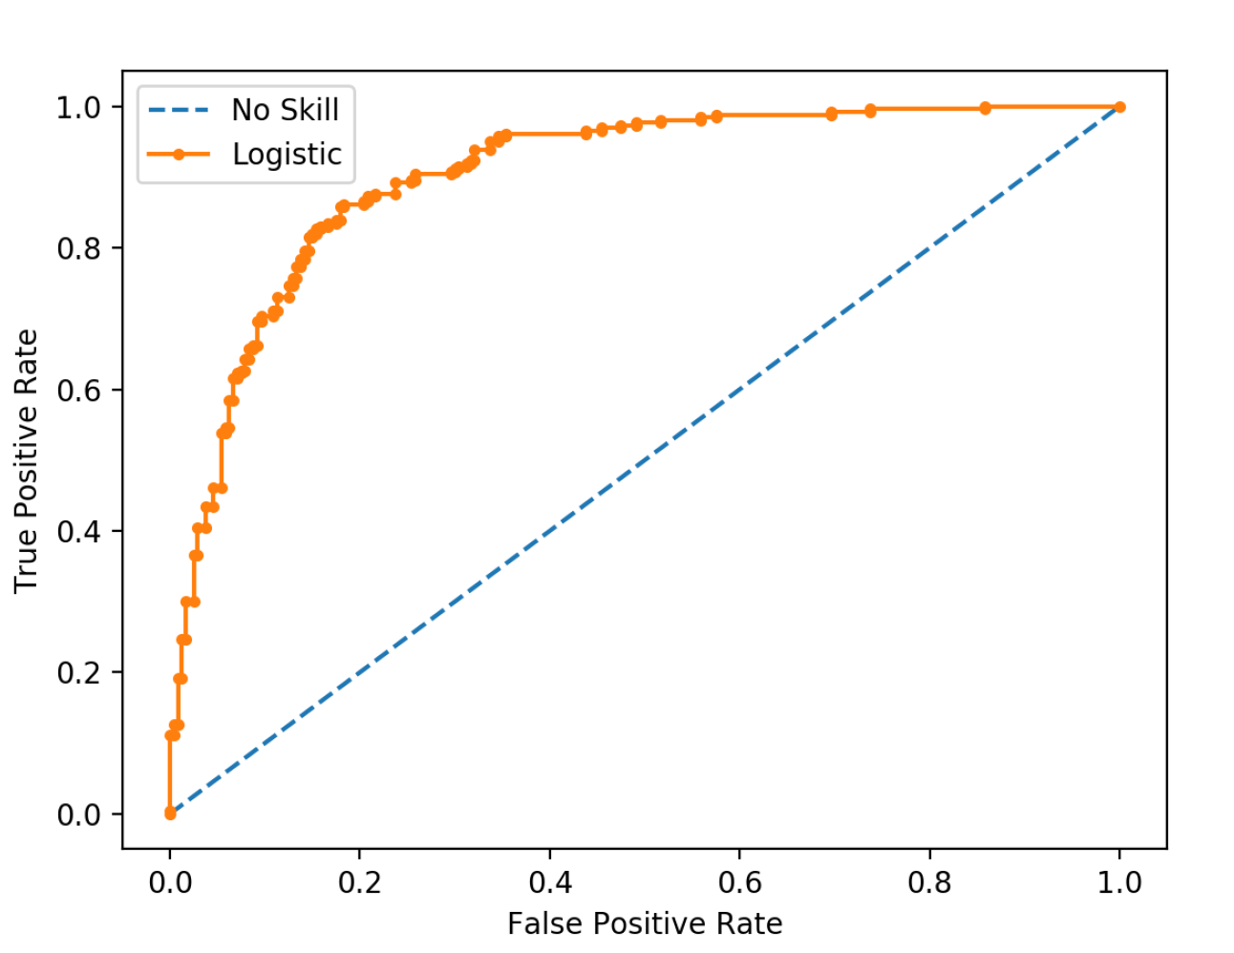
ROC
Always predict 0 (Negative Class): FPR=TPR=0
Always predict 1 (Positive Class): FPR=TPR=1

Slide 31
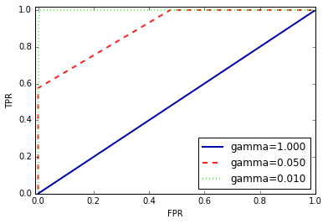
Area Under the Curve (AUC)
We can compute the area under the ROC curve using the roc_auc_score function.
It is a popular diagnostic tool for classiﬁers on balanced and imbalanced binary prediction problems alike because it is not biased to the majority or minority class.
Although widely used, the ROC AUC is not without problems. For imbalanced classiﬁcation with a severe skew and few examples of the minority class, the ROC AUC can be misleading. This is because a small number of correct or incorrect predictions can result in a large change in the ROC Curve or ROC AUC score.

Slide 32
AUC
Use AUC when evaluating models on imbalanced data.
Adjusting the decision threshold might be necessary to obtain useful classification results from a model with a high AUC.

Slide 33
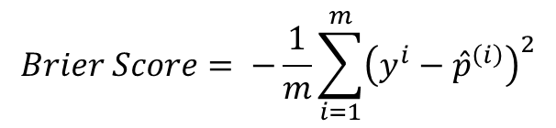
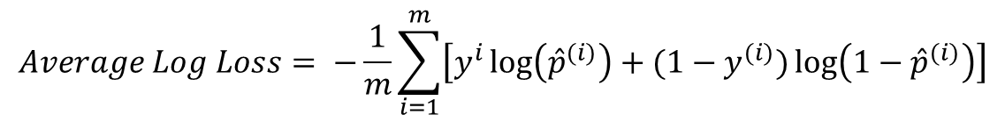

Probability Scoring Methods
$$Average Log Loss= −\frac{1}{m}\sum_{i=1}^{m}{\left[y^{i}\log\left({\hat{p}}^{(i)}\right)+(1−y^{(i)})\log\left(1−{\hat{p}}^{(i)}\right)\right]}$$
$$Brier Score= −\frac{1}{m}\sum_{i=1}^{m}{{\left(y^{i}−{\hat{p}}^{\left(i\right)}\right)}^{2}}$$
The Brier score, calculates the mean squared error between predicted probabilities and the expected values. It takes the probabilities for the positive class only and returns an average score.
The Brier scores can become very small
Transform the score using a reference score, such as the no skill classiﬁer. This is called a Brier Skill Score, or BSS, and is calculated as follows:
$$BSS=1−\frac{BrierScore}{BrierScore_{ref}}$$

Slide 34
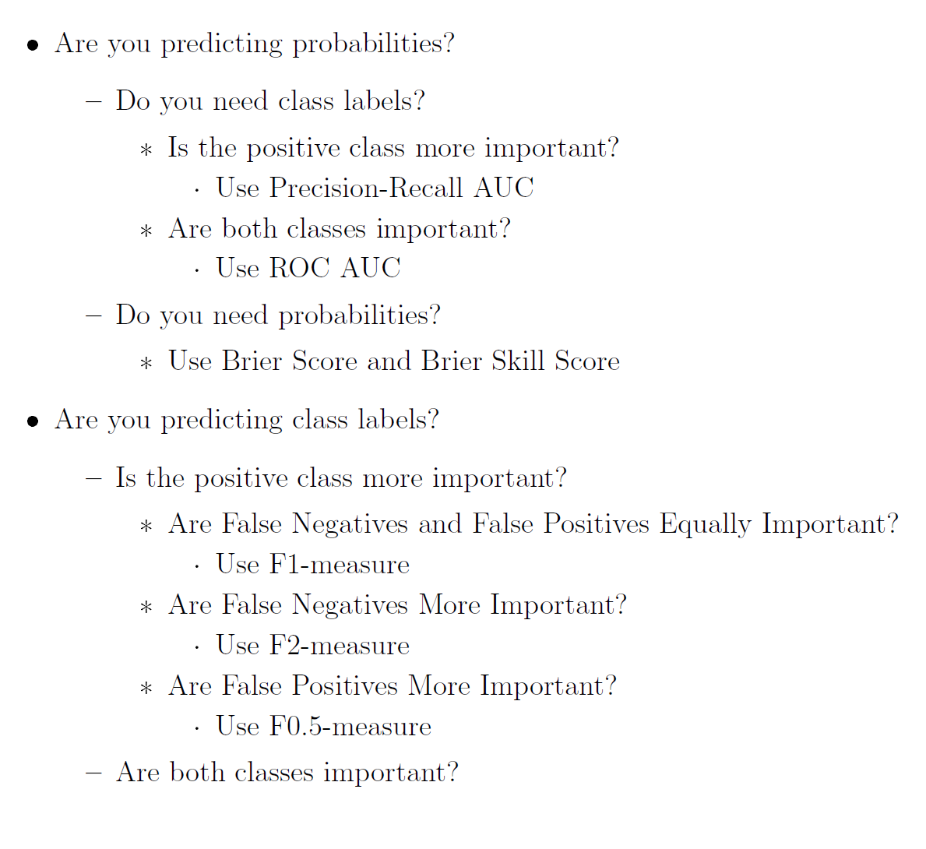
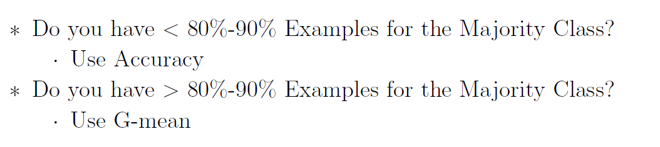
How to choose metric
Here are some ﬁrst-order suggestions (from book - Imbalance classification with Python ((Page 45-56) –Jason Brownlee. The ebook is available for purchase from https://machinelearningmastery.com/

Slide 35
Using Evaluation Metrics in Model Selection
scoring argument

Slide 36
Cross Validation Considerations
Use stratiﬁed k-fold cross-validation, which ensures that the proportion of positive to negative examples found in the original distribution is respected in all the folds.
GridSearchCV – uses stratified k-fold cross validation by default when the estimator is a classifier and outcome is either binary or multiclass.
Split into train/test sets with same class ratio
trainX, testX, trainy, testy = train_test_split(X, y, test_size=0.5, random_state=2,stratify=y)

Slide 37
Data Sampling

Slide 38
Over sampling
Random Oversampling-randomly duplicates examples from the minority class in the training dataset
Synthetic Minority Oversampling Technique (SMOTE) -selects examples from minority class that are close in the feature space
Borderline-SMOTE- selecting those instances of the minority class that are misclassiﬁed, such as with a k-nearest neighbor classiﬁcation model.
Borderline Oversampling with SVM
Adaptive Synthetic Sampling (ADASYN)-generates synthetic samples inversely proportional to the density of the examples in the minority class.

Slide 39
Cost Sensitive Learning

Slide 40
Cost Sensitive Learning
Cost-Sensitive Learning is a type of learning that takes the misclassiﬁcation costs into consideration.
Assign different cost to false negative and false positive and minimize total cost.
The scikit-learn Python machine learning library provides examples of these cost-sensitive extensions via the class weight argument

Slide 41
Weighted Logistic Regression
$$J\left(θ\right)=−\frac{1}{m}\sum_{i=1}^{m}{\left[y^{i}\log\left({\hat{p}}^{(i)}\right)+(1−y^{(i)})\log\left(1−{\hat{p}}^{(i)}\right)\right]}$$
$$J\left(θ\right)=−\frac{1}{m}\sum_{i=1}^{m}{\left[{w_{1}y}^{i}\log\left({\hat{p}}^{(i)}\right)+w_{0}(1−y^{(i)})\log\left(1−{\hat{p}}^{(i)}\right)\right]}$$
The class weighing can be deﬁned multiple ways; for example:
Domain expertise, determined by talking to subject matter experts.
Tuning, determined by a hyperparameter search such as a grid search
Heuristic, speciﬁed using a general best practice for example use the inverse of the class distribution present in the training dataset

